Slide 1
Machine Learning
Lesson 4: Feature Engineering

Slide 2

Factor Analysis
PCA
LDA
PCA, LDA in Python

Slide 3
By the end of this lesson, you will be able to:
Demonstrate feature engineering and its significance using python
Practice different feature selection techniques

Slide 4
Feature Engineering
Topic 1: Feature Selection

Slide 5
Problem Statement
Given a multidimension dataset, extract information based on interrelations among variables.
Temperature | Time | Weight | Location | Weekday | Weekend | Sales
… | … | … | … | … | … | …
… | … | … | … | … | … | …
… | … | … | … | … | … | ..
… | … | … | … | … | … | ..
… | … | … | … | … | … | …
… | … | … | … | … | … | …
Notes:
Trainer Notes: Explain the following:
The above scenario as a multi-dimensional dataset which multiple features
The significance of feature reduction within the above dataset

Slide 6
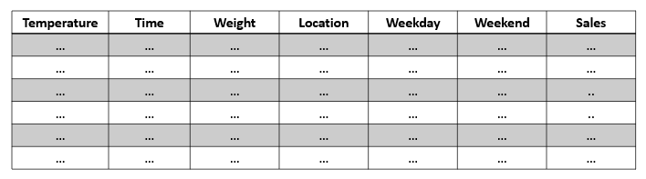

Probable Solutions
Techniques to extract feature-based information
Regression
Factor Analysis
Notes:
Trainer Notes: Explain the following:
Discuss regression and factor analysis as techniques to extract feature based information

Slide 7
Regression
Regression
Factor Analysis
Regression tells the relationship among variables and
quantifies the relationship using set of equations
Notes:
Trainer Notes: Explain the following:
Remind them about regression and how the regression line can help in extracting information.

Slide 8
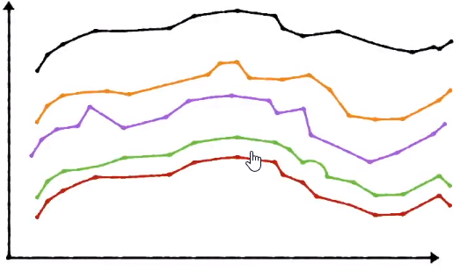

Multicollinearity Problem
Interdependence among two or more explanatory variables may lead to an unreliable model.
Solution : Perform Factor Analysis to extract underlying causes leading to this behaviour
Notes:
Trainer Notes: Explain the following:
The most important problem which arises while performing multiple linear regression
Why does this problem arise?
How the problem can be tackled

Slide 9
Factor Analysis
5
Regression
3
1
-8
-6
-4
-2
-1
2
4
6
8
-3
Factor Analysis
-5
-7
Common factors of the observations explain the variable interdependence
Notes:
Trainer Notes: Explain the following:
Significance of factor analysis
How it combats the effect of correlation among features

Slide 10





Example
The relationship between observable variables and observable outcome: sales
Pageviews
Clicks
Add to carts
Sales
Minutes browsed
Notes:
Trainer Notes: Explain the following:
The above scenario where dependent variable is sales and the independent variables are: Pageviews, clicks, add to carts and minutes browsed.

Slide 11

Example (Contd.)
There may be few underlying causes which can affect the output apart from the observed ones:
Pageviews
Clicks
Add to carts
Minutes Browsed
Sessions
Selection
Marketing spend
Pricing
Sales
Observed causes
Underlying causes
Effect
Note: Identifying underlying causes helps in accurate sales prediction
Notes:
Trainer Notes: Explain the following:
Few underlying causes were also affecting sales apart from the observed causes
These underlying causes were a result of some research
Provide an analogy to dimensionality reduction by mapping the above observed causes to underlying causes

Slide 12
Feature Engineering
Topic 2: Factor Analysis
Notes:
Trainer Notes: Explain the following:
Factor Analysis
Significance of factor analysis

Slide 13
Factor Analysis Process
There may be few underlying causes which can affect the output, apart from the observed ones:
Principal Component Analysis (PCA)
Linear Discriminant Analysis (LDA)
Extracts hidden factors from the dataset
Reduces Dimensions
Defines your data using less number of components, explaining the variance in your data
Searches for a linear combination of variables that best separates 2 classes
Reduces the computational complexity
Reduces the degree of overfitting
Determines whether a new data point is part of the group of data points from your training set
Determines how to classify a new observation out of a group of classes
Notes:
Trainer Notes: Explain the following:
Techniques to perform dimensionality reduction: PCA and LDA
Compare PCA and LDA
Add more significant differences in PCA and LDA

Slide 14
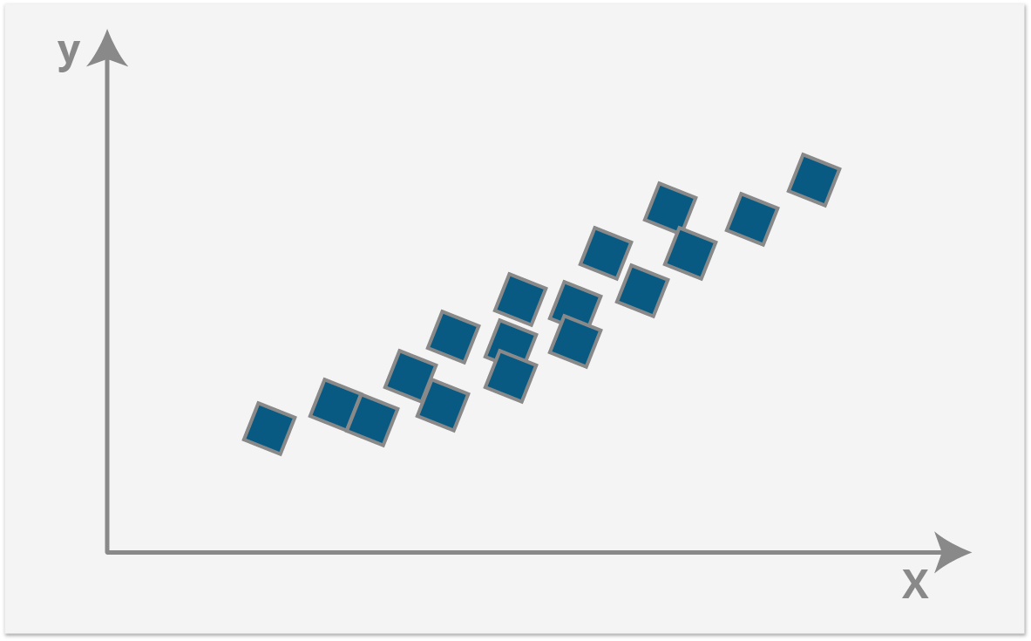
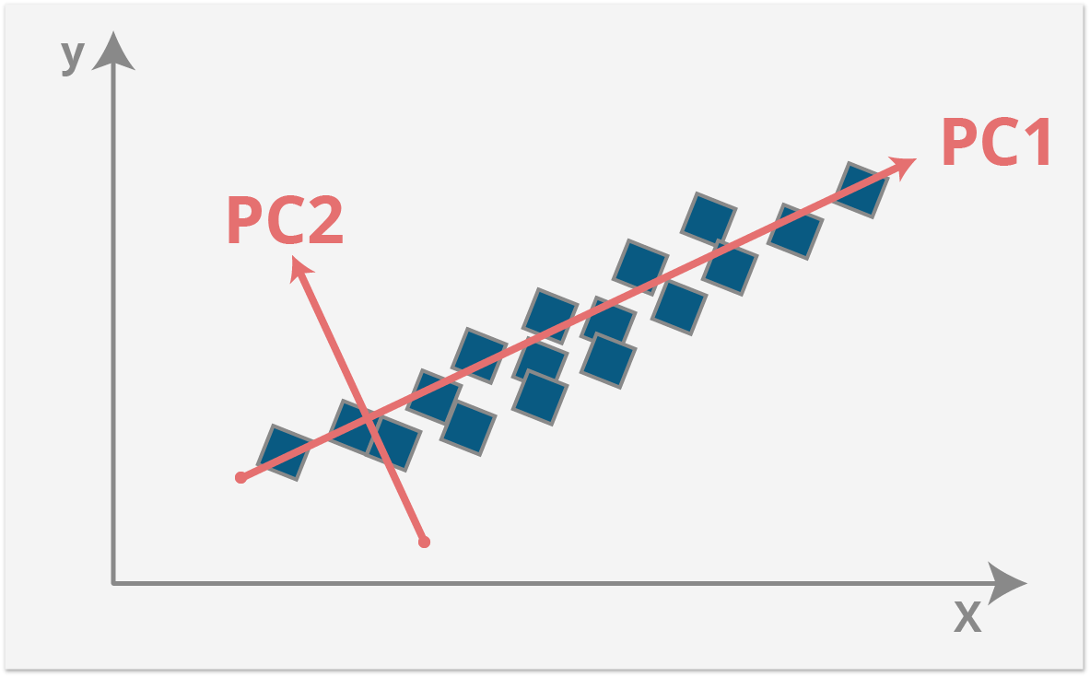
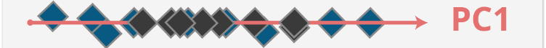
Principal Component Analysis
You have data on the x and y axis
Applying PCA: New set of axes are achieved, denoted as PC1 and PC2
Data around PC2 projected along PC1 to ensure no variance is lost
Notes:
Trainer Notes: Explain the following:
The above scenario
How does PCA works (orthogonal vectors, no variance lost)
Result post PCA application

Slide 15
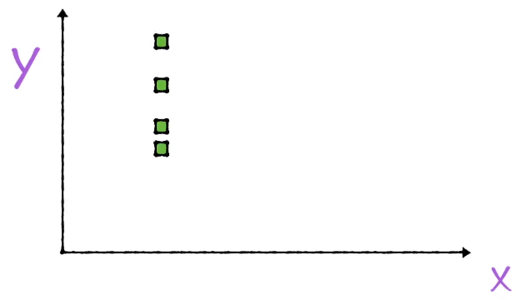


Direction of Maximum Variance
New set of axes are found to be orthogonal to each other
Projection along x axis
y
2D Data
X
Projection along y axis
Notes:
Trainer Notes: Explain the following:
What is the direction of maximum variance
How the direction of maximum variance selected
New set of axes found are orthogonal to each other

Slide 16
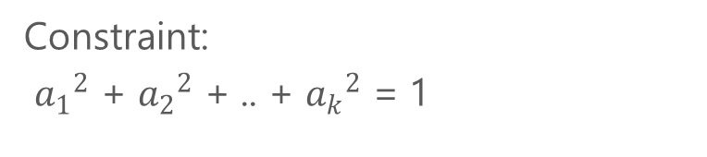
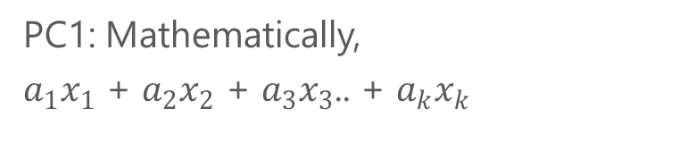
Finding PC1
The first principal component is the direction of maximum variance and is obtained by solving eigen vectors
PC1: Mathematically,
$a_{1}x_{1}$ + $a_{2}x_{2}$ + $a_{3}x_{3}$.. + $a_{k}x_{k}$
01
Constraint:
${a_{1}}^{2}$ + ${a_{2}}^{2}$ + .. + ${a_{k}}^{2}$ = 1
02
Principal Component 1
Eigen Decomposition is used to solve the above equation
03
Note: Solution of Eigen Decomposition is out of scope of this course. For more details visit: https://en.wikipedia.org/wiki/Eigendecomposition_of_a_matrix
Notes:
Trainer Notes: Explain the following:
Theory of finding first principal component
What is the significance of Eigen Decomposition
You can ask the learners to refer the above link for a mathematical explanation of eigen decomposition

Slide 17

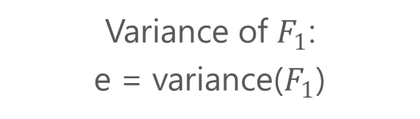

Results of Eigen Decomposition
Solution of eigen vectors results into eigen values
Eigen Vector
Principal Component
Eigen Value
Values from $a_{1}$ to $a_{k}$ form Eigen Vector
$V_{1}$ = [$a_{1}$, $a_{2}$, $a_{3}$, .., $a_{K}$]
One eigen vector corresponds to each principal component
Derived by multiplying the original data matrix with the eigen vector $V_{1}$: $F_{1}$ = $a_{1}x_{1}$ + $a_{2}x_{2}$ + .. + $a_{k}$
Variance of $F_{1}$:
e = variance($F_{1}$)
Notes:
Trainer Notes: Explain the following:
Results of eigen decomposition
Significance of eigen vector and eigen value in finding principal component

Slide 18
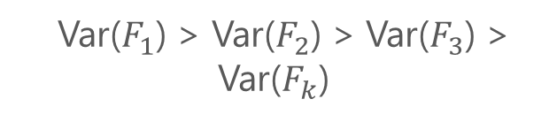
Eigen Values and PCA
Eigen values are the variances of principal components arranged in descending order
$F_{1}$, $F_{2}$, $F_{3}$, …., $F_{k}$
Var($F_{1}$) > Var($F_{2}$) > Var($F_{3}$) > Var($F_{k}$)
Eigenvalue 1 > Eigenvalue 2 > Eigenvalue 3 > Eigenvalue k
Notes:
Trainer Notes: Explain the following:
Ordering principal components w.r.t eigen values

Slide 19
Assisted Practice
Factor Analysis
Duration: 15 mins.
Problem Statement: The dataset you are going to use in this practice is the famous Iris data set. The dataset consists of 150 records of Iris plant with four features: “sepal-length”, “sepal-width”, “petal-length”, and “petal-width”. All the features are numeric. The records have been classified into one of the three classes, that is, “Iris-setosa”, “Iris-versicolor”, or “Iris-verginica”.
Objective:
Train the models on original number of features
Reduce the number of variables by merging correlated variables
Extract the most important features from the dataset that are responsible for maximum variance in the output.
Access: Click on the Labs tab on the left side panel of the LMS. Copy or note the username and password that are generated. Click on the Launch Lab button. On the page that appears, enter the username and password in the respective fields, and click Login.
Notes:
Trainer Notes:
Perform the above demo with the iris dataset, preloaded in scikitlearn.datasets
Ask the learners to perform the same on their local system

Slide 20
Unassisted Practice
Factor Analysis Duration: 15 mins.
Problem Statement: Scikit learn comes with pre-loaded datasets, load the digits dataset from that collection (http://scikit-learn.org/stable/auto_examples/datasets/plot_digits_last_image.html). Using Scikit learn perform a PCA transformation such that the transformed dataset can explain 95% of the variance in the original dataset. Find out the number of components in the projected subspace.
Objective: Understand and practice principal component analysis using Scikit learn.
Note: This practice is not graded. It is only intended for you to apply the knowledge you have gained to solve real-world problems.
Access: Click on the Labs tab on the left side panel of the LMS. Copy or note the username and password that are generated. Click on the Launch Lab button. On the page that appears, enter the username and password in the respective fields, and click Login.
Notes:
Trainer Notes: Explain the following:
The above scenario and problem statement

Slide 21
Data Import and Split
Below is the code for importing and splitting the dataset:
Code
import sklearn
from sklearn.datasets import load_digits
digits = load_digits()
X = digits.data
y = digits.target
from sklearn.model_selection import train_test_split
X_train, X_test, y_train, y_test = train_test_split(X, y, test_size=0.2, random_state=1)
print(X_train.shape)

Slide 22

PCA Transformation
Transforming the train and test sets such that they explain 95% of variance
Code
from sklearn.decomposition import PCA
sklearn_pca = PCA(n_components=0.95)
sklearn_pca.fit(X_train)
X_train_transformed = sklearn_pca.transform(X_train)
print(X_train_transformed.shape)
print(X_test.shape)
X_test_transformed =sklearn_pca.transform(X_test)
print(X_test_transformed.shape)
Notes:
Trainer Notes:
Explain why n_components=0.95.

Slide 23
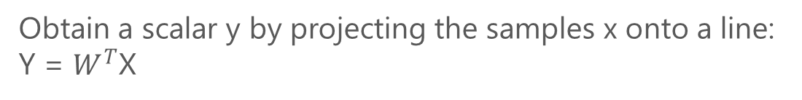
Linear Discriminant Analysis (LDA)
Assume a set of D - dimensional samples {X(1, X(2, …, X(N}, N1 of which belong to class ω1 and N2 to class ω2
Obtain a scalar y by projecting the samples x onto a line: Y = $W^{T}$X
Of all the possible lines, select the one that maximizes the separability of the scalars
Notes:
Trainer Notes: Explain the following:
Explain linear discriminant analysis
How lda performs dimensionality reduction
How it can be used for classification as well

Slide 24
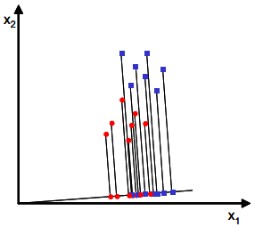
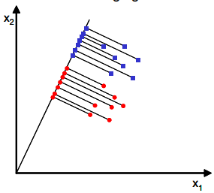
Maximum Separable Line
The maximum separable line finds out the feature subspace such that class separability is also optimized
Notes:
Trainer Notes: Explain the following:
How the maximum separable line is obtained
Why maximum separable line is considered

Slide 25
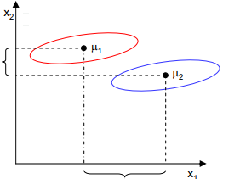


Finding Maximum Separable Line
Measure of separation
Better class separability
Linear Discriminant
Mean vector within each class of x and y is:
Objective function is the distance between the projected means:
Larger difference between the means
Optimum projection
Finding the maxima
Notes:
Trainer Notes:
Explain the mathematics

Slide 26
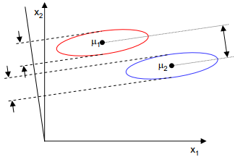

Finding Maximum Separable Line (Contd.)
Measure of separation
Linear Discriminant
Optimum projection
Function of difference between the means normalized by measure of scatter(an equivalent variance):
Obtain the maxima
Variables from same class are projected very close to each other and at the same time, the projected means are as farther apart as possible
Notes:
Trainer Notes:
Explain the mathematics

Slide 27





Finding Maximum Separable Line (Contd.)
Measure of separation
A measure of the scatter in multivariate feature space x:
Scatter of the projection y can be expressed as a function of the scatter matrix in feature space x
Difference between the projected means
, $S_{w}$ is the within class scatter matrix
Linear Discriminant
Optimum projection
$S_{w}$ is the within class scatter
Obtain the maxima
Notes:
Trainer Notes:
Explain the mathematics

Slide 28


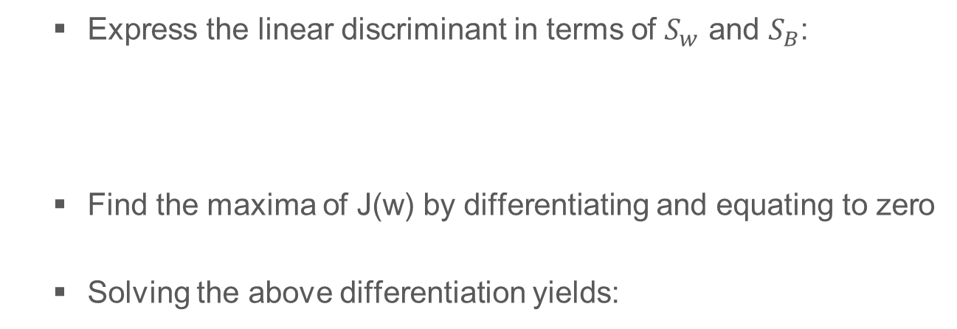
Finding Maximum Separable Line (Contd.)
Measure of separation
Express the linear discriminant in terms of $S_{w}$ and $S_{B}$:
Find the maxima of J(w) by differentiating and equating to zero
Solving the above differentiation yields:
Linear Discriminant
Optimum projection
Obtain the maxima
Above is the optimal direction for projection
Notes:
Trainer Notes:
Explain the mathematics

Slide 29
Assisted Practice
Factor Analysis
Duration: 10 min.
Problem Statement: Consider the iris dataset preloaded within the mlxtend library. Segregate the data and labels accordingly and transform the data to two linear discriminants.
Objective: Perform LDA as a dimensionality reduction technique.
Access: Click on the Labs tab on the left side panel of the LMS. Copy or note the username and password that are generated. Click on the Launch Lab button. On the page that appears, enter the username and password in the respective fields, and click Login.
Notes:
Trainer Notes:
Use the mlxtend library to download the preloaded iris dataset
Download the corresponding .ipynb file for further steps

Slide 30
Unassisted Practice
Factor Analysis Duration: 15 min.
Problem Statement: Scikit learn comes with pre-loaded datasets, load the digits dataset from that collection (http://scikit-learn.org/stable/auto_examples/datasets/plot_digits_last_image.html). Using Scikit learn perform LDA on the dataset. Find out the number of components in the projected subspace. Transform the dataset and fit a logistic regression and observe the accuracy. Compare it with the previous model based on PCA in terms of accuracy and model complexity.
Objective: Understand and practice LDA using Scikit learn.
Note: This practice is not graded. It is only intended for you to apply the knowledge you have gained to solve real-world problems.
Access: : Click on the Labs tab on the left side panel of the LMS. Copy or note the username and password that are generated. Click on the Launch Lab button. On the page that appears, enter the username and password in the respective fields, and click Login.
Notes:
Trainer Notes: Explain the following:
The above problem scenario.

Slide 31
Import and Split
Import the load_digits dataset from scikit learn and split it accordingly
Code
import sklearn
from sklearn.datasets import load_digits
digits = load_digits()
X = digits.data
y = digits.target
from sklearn.model_selection import train_test_split
X_train, X_test, y_train, y_test = train_test_split(X, y, test_size=0.2, random_state=1)
print(X_train.shape)

Slide 32
Number of Components in Transformed Shape
Fit LDA on the training data
Code
from sklearn.linear_model import LogisticRegression
from sklearn.discriminant_analysis import LinearDiscriminantAnalysis as lda
sklearn_lda = lda()
sklearn_lda.fit(X_train,y_train)
X_train = sklearn_lda.transform(X_train)
print("Number of components in transformed shape {}".format(X_train.shape[1]))

Slide 33
Dataset Transformation
Transforming the test data
Code
#sklearn_lda.transform(X_test)
X_test =sklearn_lda.transform(X_test)
print(X_test.shape)

Slide 34
Fitting a Logistic Regression Model
Code
lr = LogisticRegression(penalty='l1')
lr.fit(X_train,y_train)
y_predict = lr.predict(X_test)
from sklearn.metrics import accuracy_score
accuracy = accuracy_score(y_predict,y_test)
print(accuracy)
Notes:
Trainer Notes:
Explain the significance of penalty='11'

Slide 35
Now, you are able to:
Demonstrate feature engineering and its significance using python
Practice different feature selection techniques

Slide 36

© Simplilearn. All rights reserved.

Slide 37
Dimensionality reduction algorithms are one of the possible ways to reduce the computation time required to build a model.
1
True
False
© Simplilearn. All rights reserved.

Slide 38
Dimensionality reduction algorithms are one of the possible ways to reduce the computation time required to build a model.
1
True
False
a. True
By reducing the dimensions of data, it will take less time to train a model.

Slide 39
Which of the following is/are true about PCA?
1. PCA is an unsupervised method
2. It searches for the directions with the data having the largest variance
3. Maximum number of principal components <= number of features
4. All principal components are orthogonal to each other
2
1 and 2
1, 2, and 4
1, 2, and 3
All the above
© Simplilearn. All rights reserved.

Slide 40
Which of the following is/are true about PCA?
1. PCA is an unsupervised method
2. It searches for the directions with the data having the largest variance
3. Maximum number of principal components <= number of features
4. All principal components are orthogonal to each other
2
1 and 2
1, 2, and 4
1, 2, and 3
All the above
d. All the above
All the above options are true.

Slide 41
Lesson-End Project
Duration: 20 mins.
Problem Statement: John Cancer Hospital (JCH) is a leading cancer hospital in USA. It specializes in preventing breast cancer. Over the last few years, JCH has collected breast cancer data from patients who came for screening/treatment. However, this data has almost 30 attributes and is difficult to run and interpret the result. You as an ML expert, has to reduce the no. of attributes (Dimensionality Reduction) so that results are meaningful and accurate.
Objective: Reduce the number of attributes/features in data to make the analysis of the results comprehensible to doctors.
Access: Click the Labs tab in the left side panel of the LMS. Copy or note the username and password that are generated. Click the Launch Lab button. On the page that appears, enter the username and password in the respective fields and click Login.
Notes:
Trainer Notes: Explain the project to the learners and instruct them to perform it after the lesson.

Slide 42
© Simplilearn. All rights reserved.

